Slide 1
Data Representation
Fundamentals of Programming in Python - Spring 2023
Presenter: Mohammad Parsa Bashari

Slide 2
TOC
Overview
Data Types in Python
Basic Structure of a Computer
Memory
Number Systems
Bitwise Operations
Negative Numbers
Real Numbers
Characters and Strings

Slide 3
Overview
What are the data types we can use ?
How are they stored in the memory ?
What is a bit (binary digit)
Number Systems (Decimal, Binary, Octal, Hexadecimal)
Negative Numbers (Sign-Magnitude, One’s Complement, Two’s Complement)
Real Numbers (Why 0.1 + 0.2 ≠ 0.3 !)
Characters and Strings (ASCII)

Slide 4
Data Types in Python
Go to colab!
Python Data Types
Numeric
Boolean
Dictionary
Sequence
Set
Integer
Float
Complex
String
List
Tuple

Slide 5
Basic Structure of a Computer
Main Memory
(Random Access Memory)
CPU
Input Device
CU
ALU
Output Device
Registers

Slide 6
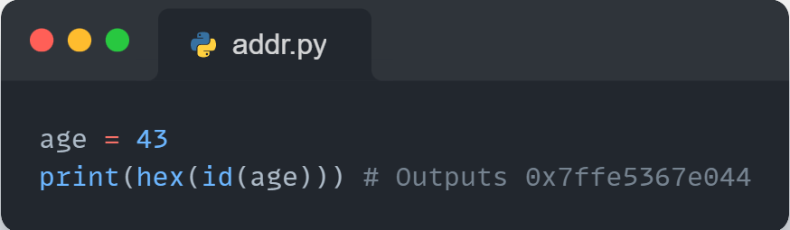
Memory
Go to colab!
Bit (Binary Digit)
Byte
Word
Address

Slide 7
Number Systems
Decimal (base-10) : 0,1,2,3,4,5,6,7,8,9
Example: (7594.36)₁₀ = (7 × 10³ ) + (5 × 10² ) + (9 × 10¹ ) + (4 × 10⁰ ) + (3 × 10⁻¹) + (6 × 10⁻²)
Octal (base-8) : 0,1,2,3,4,5,6,7
Hexadecimal (base-16) : 0,1,2,3,4,5,6,7,8,9,A,B,C,D,E,F
Example: (1F5)₁₆ = (1 × 16²) + (15 × 16¹) + (5 × 16⁰) = 501
Binary (base-2) : 0,1
Example: (1010)₂ = (1 × 2³) + (0 × 2²) + (1 × 2¹) + (1 × 2⁰) = 10
Go to colab!

Slide 8
Bitwise Operations
Go to colab!
Operator | Name | Description
& | And | Sets each bit to 1 if both bits are 1
| | Or | Sets each bit to 1 if one of two bits is 1
^ | Xor | Sets each bit to 1 if only one of two bits is 1
~ | Not | Inverts all the bits
<< | Shift Left | Shift left by pushing zeros in from the right and let the leftmost bits fall off
>> | Shift Right | Shift right by pushing copies of the leftmost bit in from the left, and let the rightmost bits fall off

Slide 9
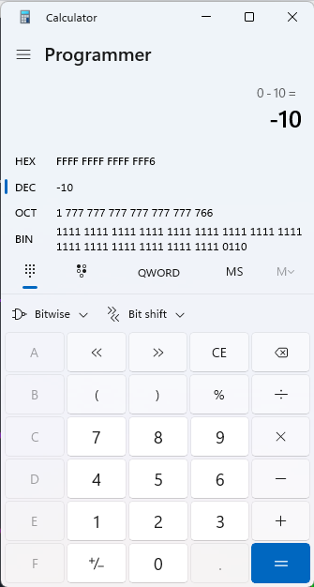
Negative Numbers
Sign-Magnitude : sign bit
Example: 0110100 = +110100 = +52₁₀
Example: 1010011 = -10011 = -19₁₀
One’s Complement : bitwise not
Example: -00001100 = -12₁₀ = 11110011
Two’s Complement : bitwise not and add 1
Example: -00001100 = -12₁₀ = 11110100
Go to colab!

Slide 10
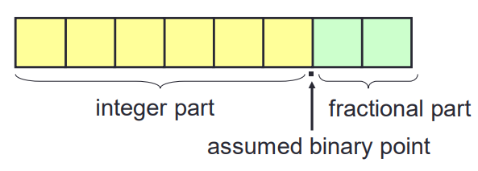
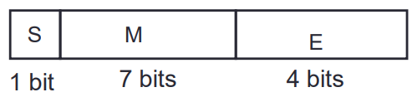
Real Numbers
Fixed-Point : limited range
Example: 011010.11 = +26.75₁₀
Floating-Point : Value = (-1)^{S} × 0.M × 2^{E-8}
Example: -3.625 = -11.101₂ = 111101001010
Example: 25.375 = +11001.011₂ = 011001011101 = 25.25!

Slide 11
Error in Float Operations
Example: Add 11.5₁₀ and 23.25₁₀
+11.5₁₀ = 010111001100 +23.25₁₀ = 010111011101
Equalizing exponents: +11.5₁₀ = 001011101101
Adding Mantissas: 0101110 + 1011101 = 10001011
Truncate LSB not MSB, So increment exponent: result = 010001011110
Consider that the result is +34.5₁₀ and NOT +34.75₁₀!

Slide 12
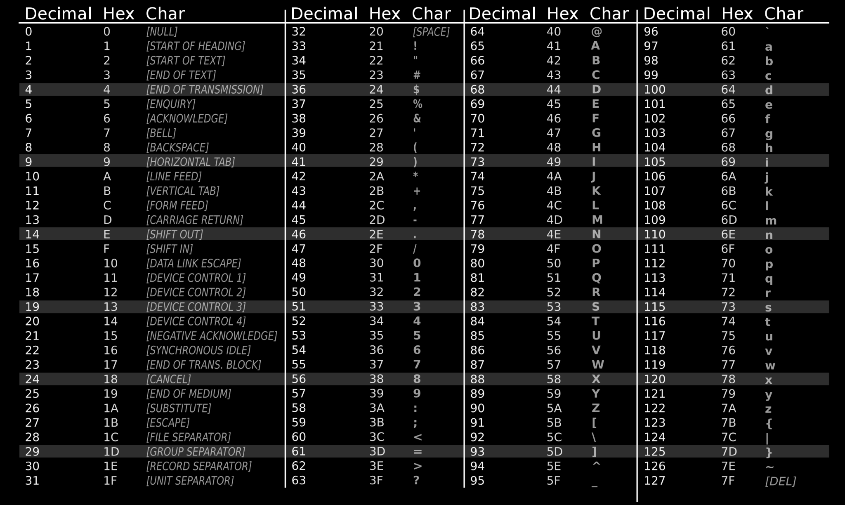
Characters and Strings
Go to colab!

Slide 13

Further Reading
IEEE 754 Floating-Point Standard:
http://steve.hollasch.net/cgindex/coding/ieeefloat.html
Online Floating-Point Converter (Based on IEEE 754 standard):
https://www.h-schmidt.net/FloatConverter/IEEE754.html

Slide 14
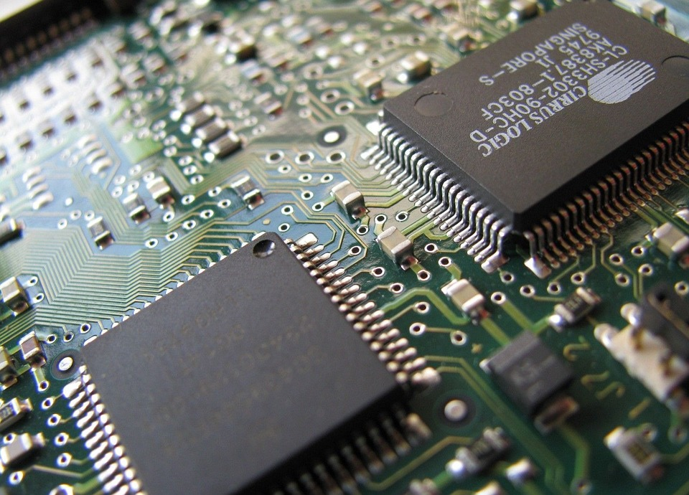



Thank you!
Contact me:
m.p.bashari@gmail.com
ParsaBashari
parsabsh

